Slide 1

Team Name : RaktSetu
Team Leader Name : AAYUSH KUMAR
Problem Statement : Design an AI solution that improves efficiency, understanding, or support within healthcare or life-sciences ecosystems.

Slide 2

Brief about the Idea:
A GPS-enabled platform that connects patients and hospitals with the nearest available blood donors instantly, reducing emergency response time.
Automated alerts, reminders, and notifications ensure quick donor response and encourage regular blood donation.
Supports organization of blood donation camps and awareness programs to build a sustainable and active donor network.
Maintains safe digital records with privacy protection and uses AI (future scope) to predict blood demand and donor availability.

Slide 3
Your solution should be able to explain the following:
BloodSync Life uses real-time GPS technology to instantly identify and connect nearby donors with patients, unlike traditional manual and static systems.
It provides an all-in-one digital platform integrating emergency alerts, donor management, donation camps, and awareness programs.
The system reduces emergency response time through automatic matching and notifications, ensuring faster and reliable blood availability.h
Its AI-ready architecture and smart reminder system support donor retention, future demand prediction, and large-scale healthcare integration.

Slide 4
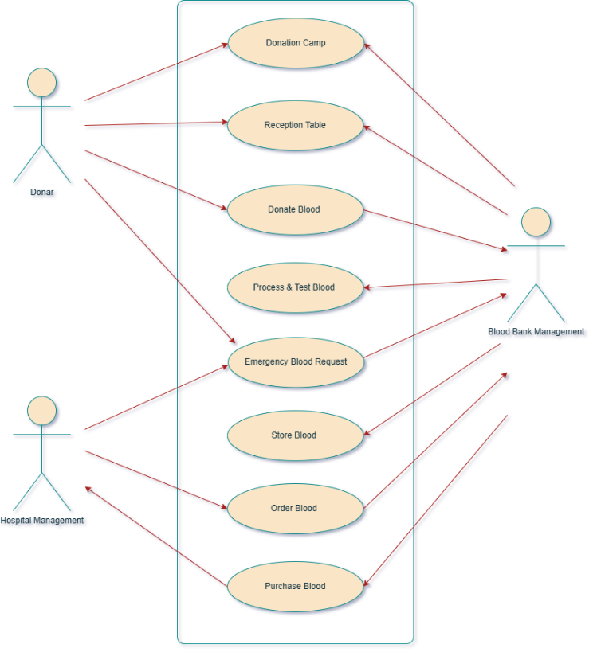
List of features offered by the solution
Real-time GPS-based donor identification and emergency alert system for quick response.
Integrated platform for donor registration, camp management, blood requests, and inventory tracking.
Secure cloud-based database with admin control and automated notifications for regular donations.
AI-ready and scalable system architecture for future demand prediction and nationwide deployment.

Slide 5
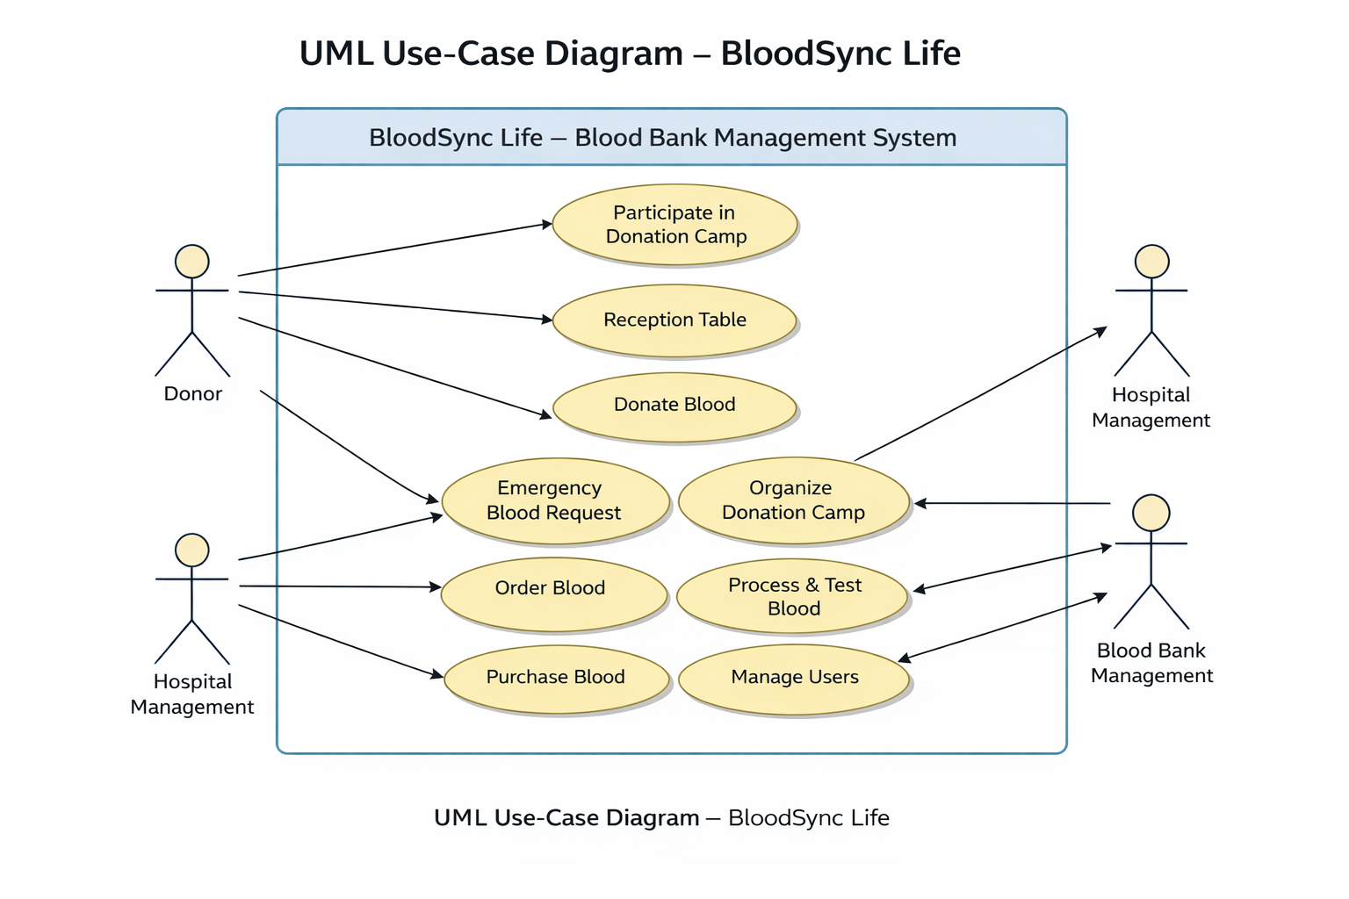
Process flow diagram or Use-case diagram

Slide 6
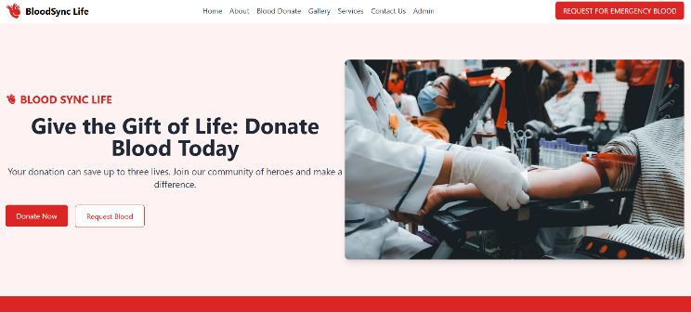
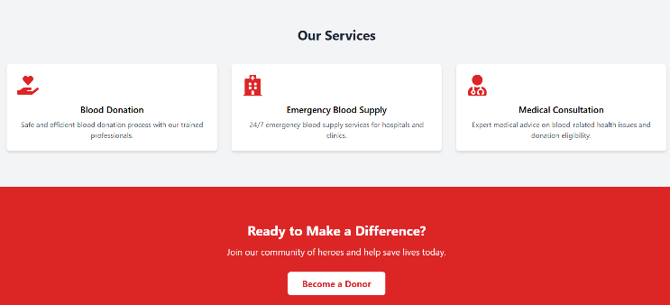
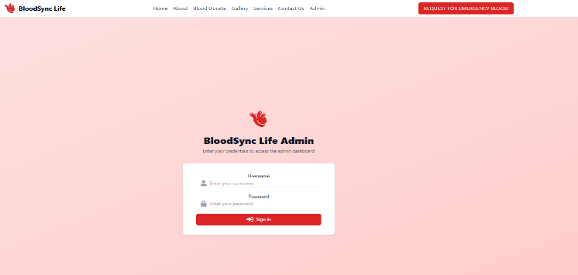

Wireframes/Mock diagrams of the proposed solution (optional)

Slide 7
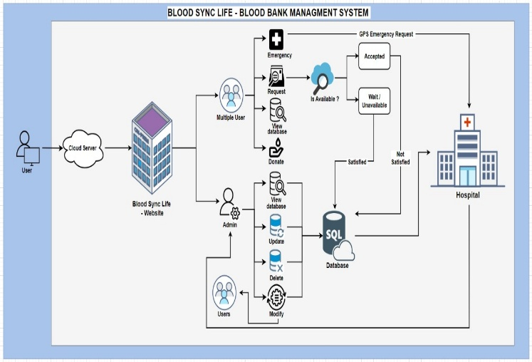
Architecture diagram of the proposed solution:

Slide 8
Technologies to be used in the solution:
Frontend Development – HTML, CSS, JavaScript, React – for building a responsive and user-friendly interface.h
Backend Development – Node.js / Java – for handling server-side logic and system operations.
Database Management:PostgreSQL / MySQL – for secure storage and management of donor and blood inventory data.
Cloud Platform: Amazon Web Services (AWS) – for hosting, scalability, and high availability.
Location & Map Services:Google Maps API – for GPS tracking and real-time donor location mapping.
AI / Machine Learning (Future Scope):Python – for predictive analytics, donor matching, and demand forecasting.

Slide 9
Estimated implementation cost (optional):
Software Development: ₹0 (Student-developed using open-source tools)
Cloud Hosting (AWS Basic Tier): ₹1,500 – ₹2,000 per month
Domain & Security (SSL): ₹1,000 per year
Database & Storage Services: ₹500 – ₹1,000 per month
Google Maps API (Free Tier): ₹0 – ₹500 per month
Maintenance & System Updates: ₹500 – ₹1,000 per month
Total Estimated Cost: ₹3,000 – ₹5,000 per month
Annual Cost (Approx.): ₹40,000 – ₹60,000
Cost Optimization: Use of free tiers, open-source tools, and cloud scalability

Slide 10


